Slide 1
Cn lab project
Designing a network for fcai
Muhammad Bilal (232442)
Fahad Noor (232448)
BSCS-EVE-F-23-C-4

Slide 2


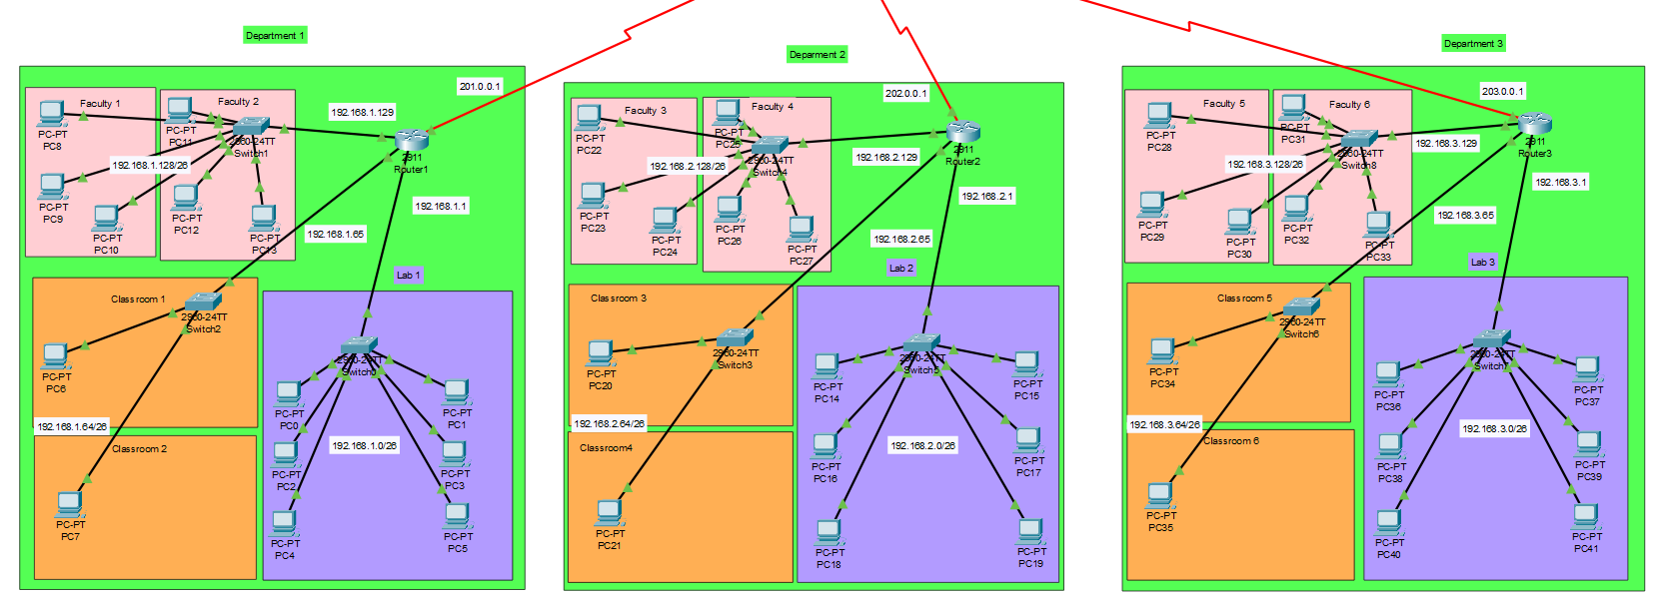

Network Topology

Slide 3
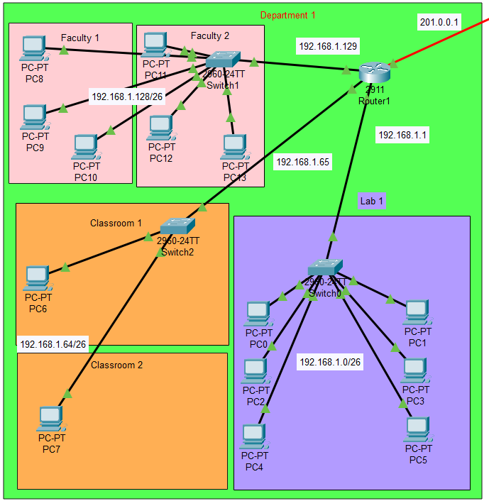
Design of Departments
The network topology for the design
is a star topology.
All the switches in a Department are connected to a Router.
The Design of Department 2 and Department 3 is similar to this.

Slide 4
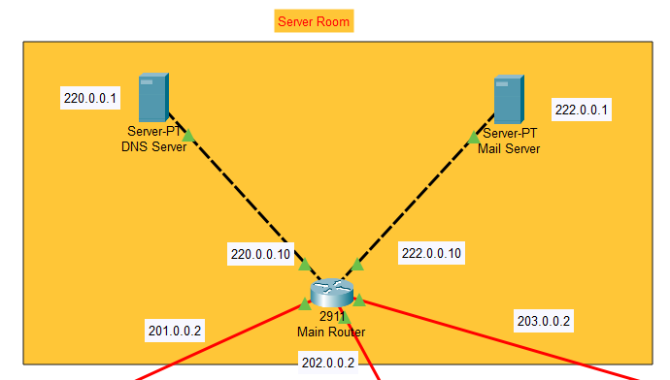
Design of Server room
The Routers of all Departments are further connected to a Main Router placed in Server Room.
Main Router connects the servers to the Departments.
DHCP Server is configured on Routers of each department.

Slide 5
Subnetting:
4 subnetworks are created each Department (out of which 3 are used).
The remaining one subnetwork is reserved for future use.
Main Router
Router 1
Router 2
Router 3
192.168.1.128/26
192.168.1.0/26
192.168.2.128/26
192.168.2.0/26
192.168.3.128/26
192.168.3.0/26
192.168.1.64/26
192.168.2.64/26
192.168.3.64/26

Slide 6
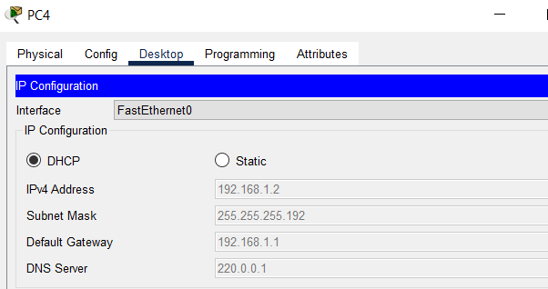
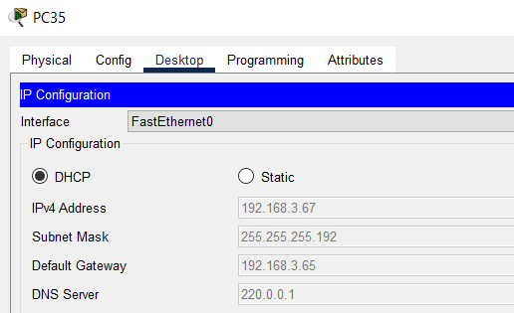
DHCP Server Configuration
DHCP Server are configured on Routers of Each Department.
Separate pool was created for each subnetwork.

Slide 7
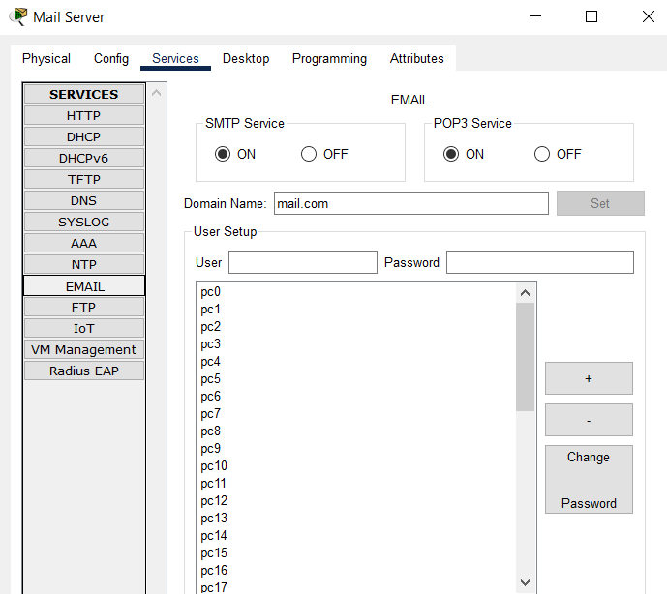
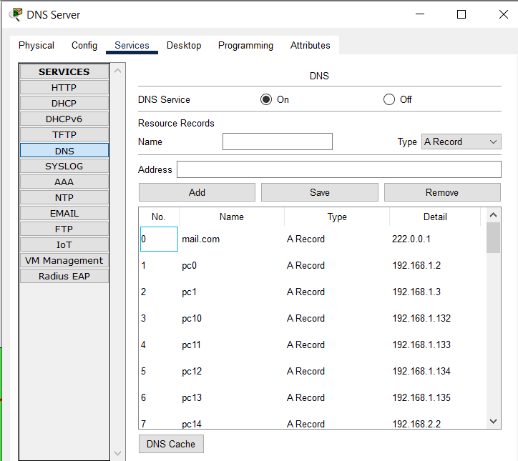
DNS and Email server Configuration
I also set up a DNS server to resolve domain names to IP addresses.
An email server was configured to handle incoming and outgoing email traffic using the domain mail.com .

Slide 8
Routing
Both Static and Dynamic Routing is used in the Network.
The Route from Server Room to the Departments is configured using Static Routing.
The Route from one Department to the other Department is configured using RIP.

Slide 9
DNS Server
Mail Server
Static Routing
Main Router
Dynamic Routing
Router 1
Router 2
Router 3
192.168.1.128/26
192.168.2.128/26
192.168.2.0/26
192.168.3.128/26
192.168.3.0/26
192.168.1.0/26
192.168.1.64/26
192.168.3.64/26
192.168.2.64/26

Slide 10
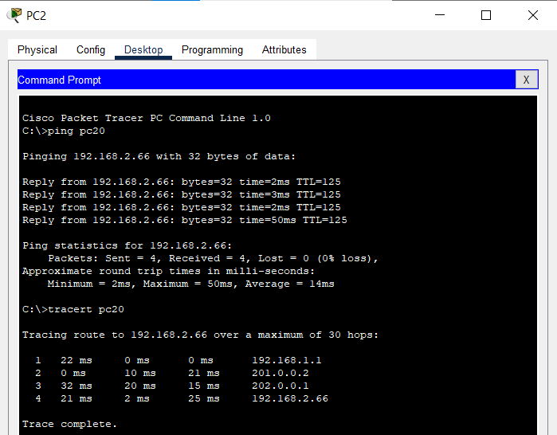
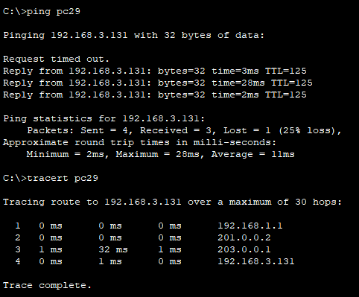
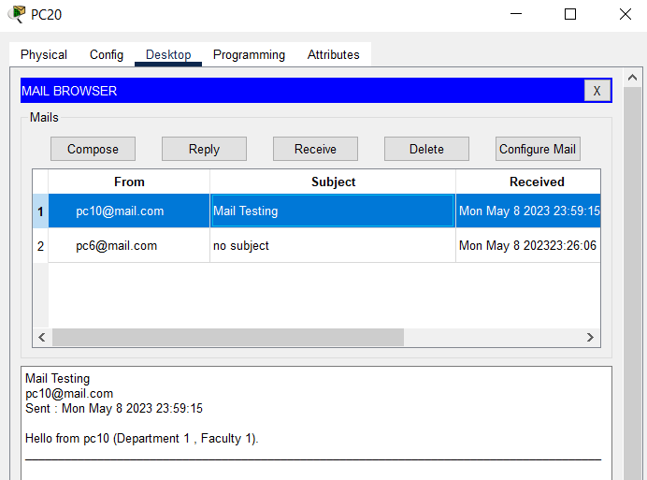
Following are the screenshot of some PING requests and mails:

Slide 11
END

